Slide 1
The Art of Compromising C2 Servers: A Web Application Vulnerabilities Perspective
Defcon 2023
Notes:
Intro here. Thank Eva and Zach here.

Slide 2

leonidas

Slide 3
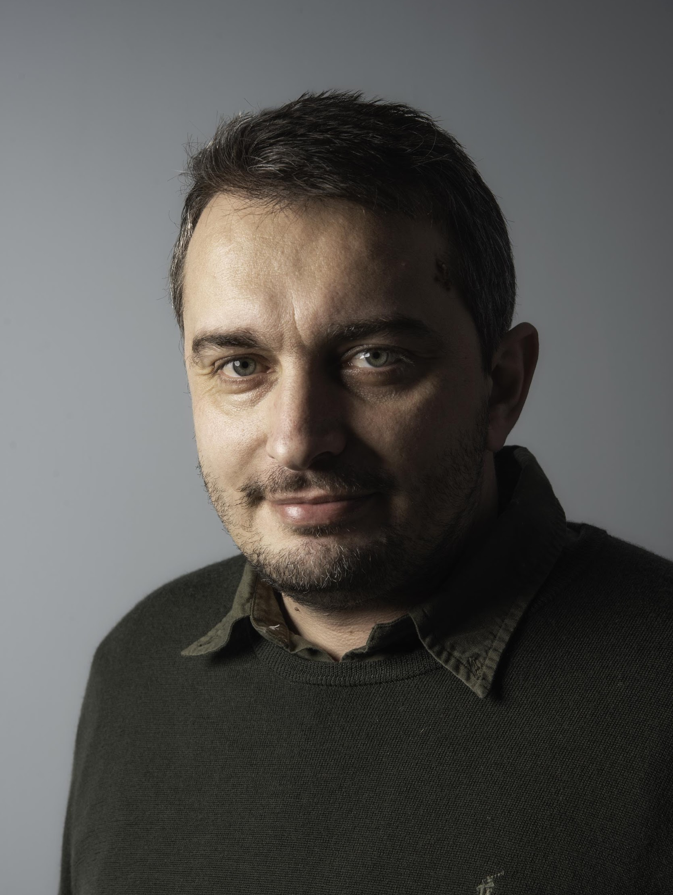
VANGELIS STYKAS
CTO at Tremau and independent security researcher
Research interests are mainly API for IoT devices and web application security
@evstykas on Twitter
Personal website: stykas.com

Slide 4
AI over APIs
Content aware AI
Target logic flaws and typical developer cut corners
Used in this talk ☺
Notes:
Τι θέλουμε: Το συναίσθημα και η κριτική που δείχνεις απέναντι στο μοντέλο συνδρομών, να περάσει στη διαφάνεια (πχ. ειρωνεία, παραίτηση, κατεργάρης, επικριτικός)

Slide 5
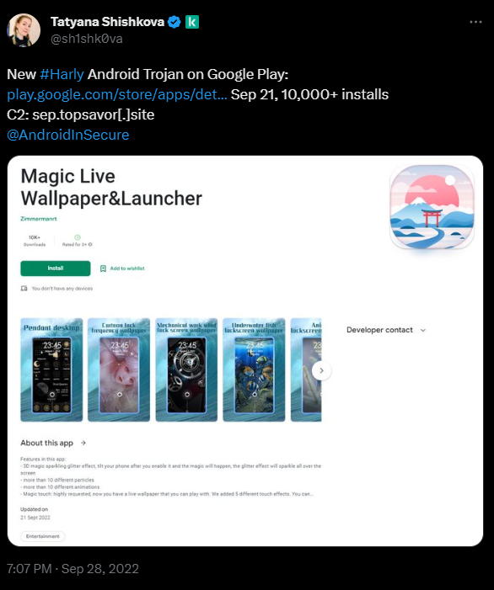
HOW IT STARTED
Doom scrolling on twitter.
Was introduced to MaaS and the wonderful Threat intel scene that tries to take them down..
Notes:
Προσοχή: Ξεκινάμε το παραμύθι, ΌΛΑ, ξεκίνησαν από ένα ΤΟΥΙ (έμφαση στην αντίθεση ΟΛΑ-ΕΝΑ)

Slide 6
MALWARE MARKET
Malware vendors also switched to the “as a service model”
Some old ones can still be acquired with a “once off” fee
Most new one want a monthly subscription varying from $100 to several thousands per month.
Notes:
Τι θέλουμε: Το συναίσθημα και η κριτική που δείχνεις απέναντι στο μοντέλο συνδρομών, να περάσει στη διαφάνεια (πχ. ειρωνεία, παραίτηση, κατεργάρης, επικριτικός)

Slide 7
MALWARE MARKET
3 Levels
Developers: People who develop malware and its functionality and their C2
Vendors : The one who take most of the profits and often advertise their goods on darknet marketplaces and aggressively seek out new customers to purchase their malware.
Buyers : Last part of the chain
Notes:
Αγρότης, μεσάζοντας, αγοραστής-εστιάτορας, θύμα - [κομμάτι από μόνο του] - this is a huge subject on its own, if one were to make a naive, dumbed down, summary, this is it.

Slide 8
MALWARE MARKET
Profits:
~2.2 billion dollars
(without ransomware)
Commonwealth of Independent States
is untouchable.
Vendors are part of criminal rigs
that enjoy immunity.

Slide 9
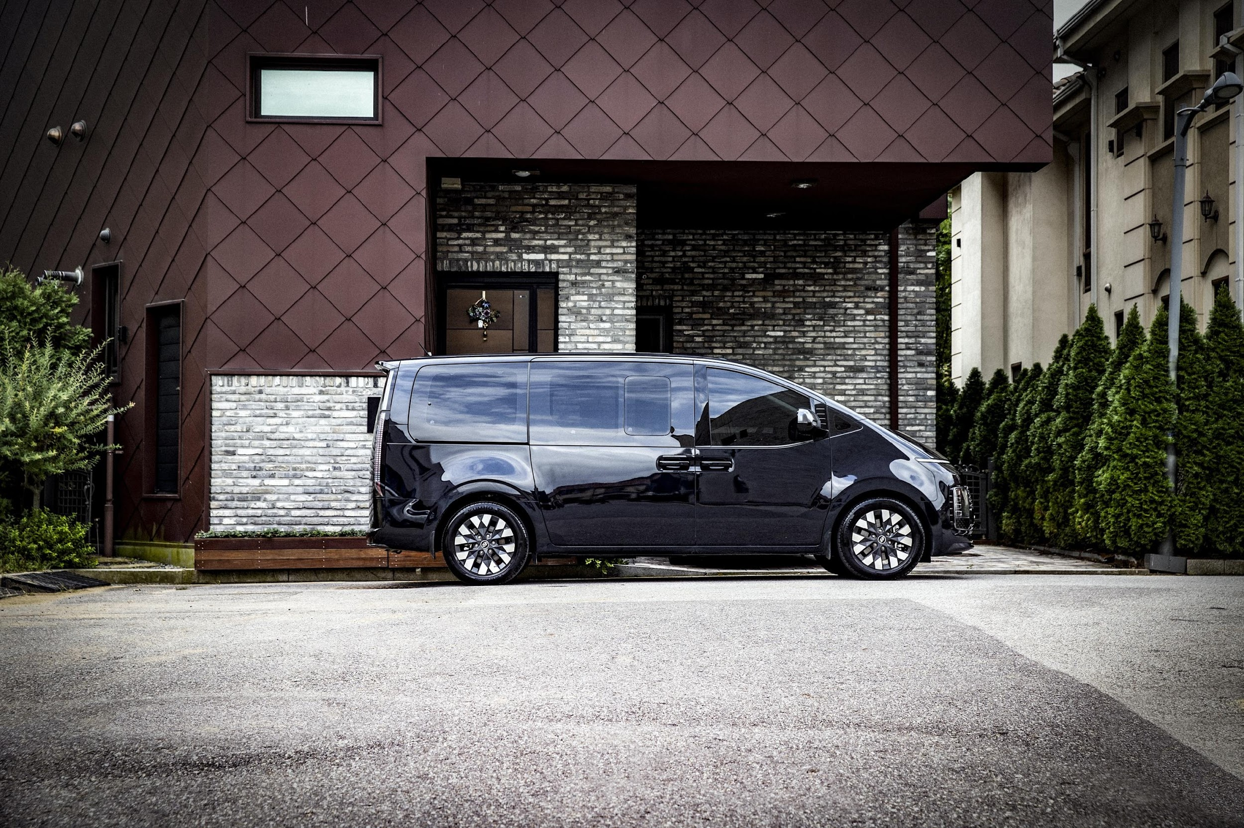

Slide 10



MALWARE 101
Android windows and mac
Delivered via a variety of methods.
Achieve persistence through a number of ways.
Heavily obfuscated and difficult to reverse.
Connects to a Command and Control (C2) server for further instructions periodically.
Notes:
Check logos

Slide 11
MALWARE LINGO
Stealer: An application that will try to steal all information and send it to C2.
Dropper: Typical basic program that is used to drop other malware to the victim.
Subscriber: App that subscribes the victim to a number of premium services.
Botnet: Duh…

Slide 12
MALWARE ANALYSIS
HIGHLY technical.
Static analysis.
Dynamic analysis in sandboxes.
Reversing and jumping through a lot of hoops.
Focus on reversing raised the bar.
If you are here for reversing tips…

Slide 13
MALWARE ANALYSIS
Potential obstacles:
Anti-debugging techniques
Obfuscation techniques
Runtime function decryption
Anti-Virtual Machine techniques
Staged downloads
Plethora of stuff that I don’t understand
Notes:
Δώσε ζωή σε κάθε ξεχωριστό εμπόδιο

Slide 14
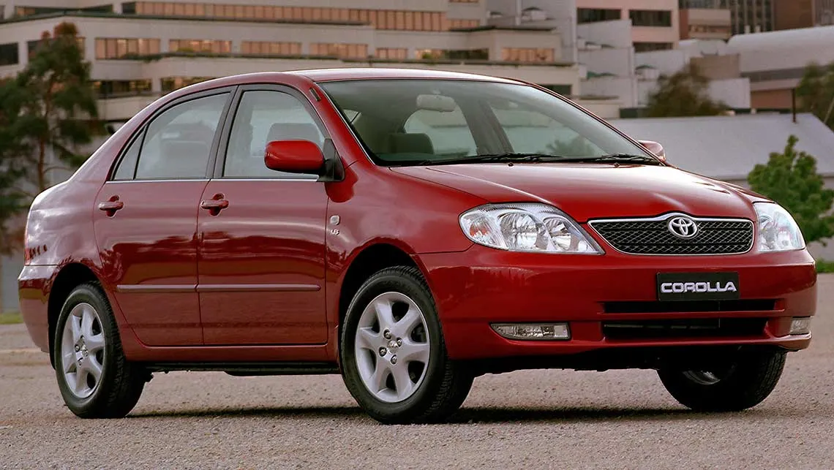
Notes:
Χαμόγελο -

Slide 15
MALWARE C2 ANALYSIS
Not that technical.
Treat C2 as a black box web app test.
If black box fails, “cheat” and use communication from the sandbox running malware.
If all else fails, run it on my victims’ devices and just proxy through burp.
Apply some “art” to it.

Slide 16
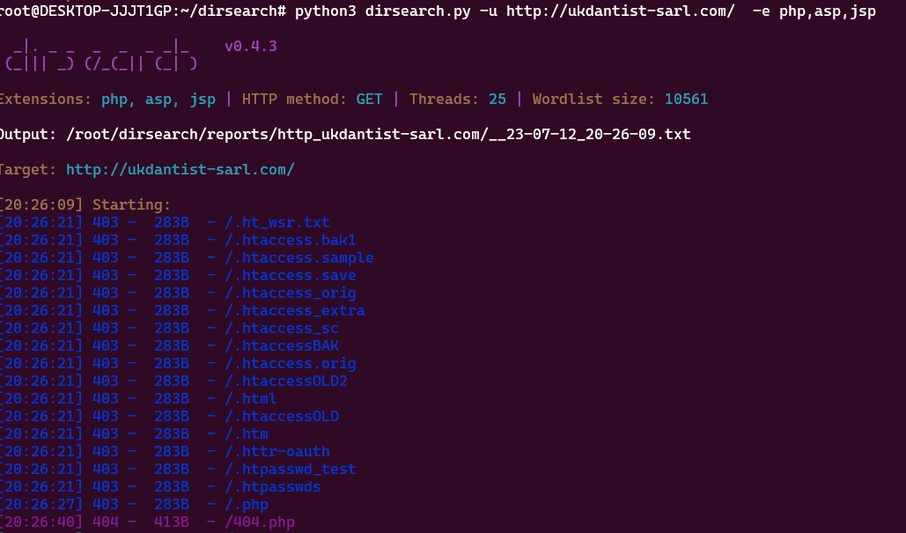
MALWARE C2 ANALYSIS
Notes:
Better screen grab - low hanging emphasis

Slide 17
MALWARE C2 ANALYSIS
Highly opportunistic - Small C2 life time.
Needs to be automated and integrated with threat intel tools to maximize the small window of time I had.
Blacklisted IP addresses - Switch machines.

Slide 18
MALWARE C2 ANALYSIS
Twitter threat intel: Check blog post for references.(but also a lot of doom scrolling.)
(no longer works. THANKS SPACE KAREN)
https://tria.ge
https://tracker.viriback.com/
https://threatfox.abuse.ch/
https://github.com/Gi7w0rm/MalwareConfigLists
Notes:
Highly suggest

Slide 19
MALWARE C2 ANALYSIS
Python script in a loop that updated a database of all targets.
Scan all targets for potential issues or exploit it immediately if there is a known vulnerability (time window).
Push notification to my phone when a new panel appeared.

Slide 20
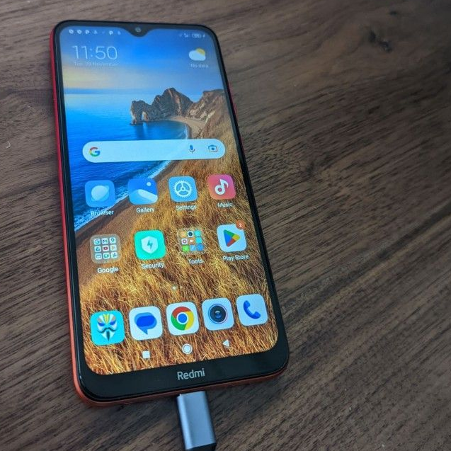
TOOLSET AND METHODOLOGY
Dirsearch
Burp Suite
Jadx Decompiler
Apklab.io
Any run
Several droplets on DigitalOcean
Shodan.io
My Cancerous Android phone

Slide 21
METHODOLOGY
Acquire C2 URL and run automated tools.
Run in sandbox and review communication logs.
Run automated tools with added knowledge.
Fire up Burp and treat it as a penetration test.
PROFIT! Submit a DEFCON talk!

Slide 22
GOALS
Get Admin access to the panel.
Get RCE on the server.
Acquire the source code of the panel
(and potentially the malware).
Don’t end up in a black VAN!

Slide 23
GOALS
Get Admin access to the panel. (7)
Get RCE on the server. (3)
Acquire the source code of the panel
(and potentially the malware). (5)
Didn’t end up in a black VAN! (YET)

Slide 24
NOT HONORABLE MENTION
Cloudflare
Hetzner
Bulletproof hosting providers

Slide 25
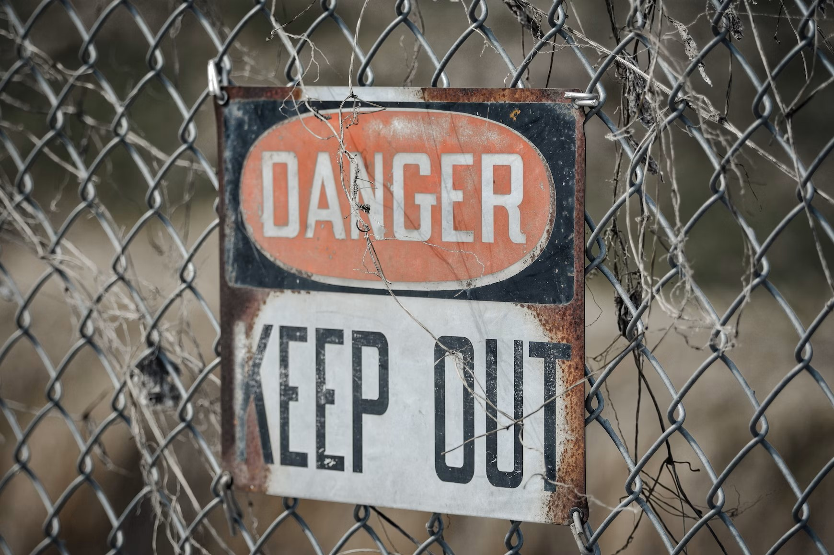

Slide 26
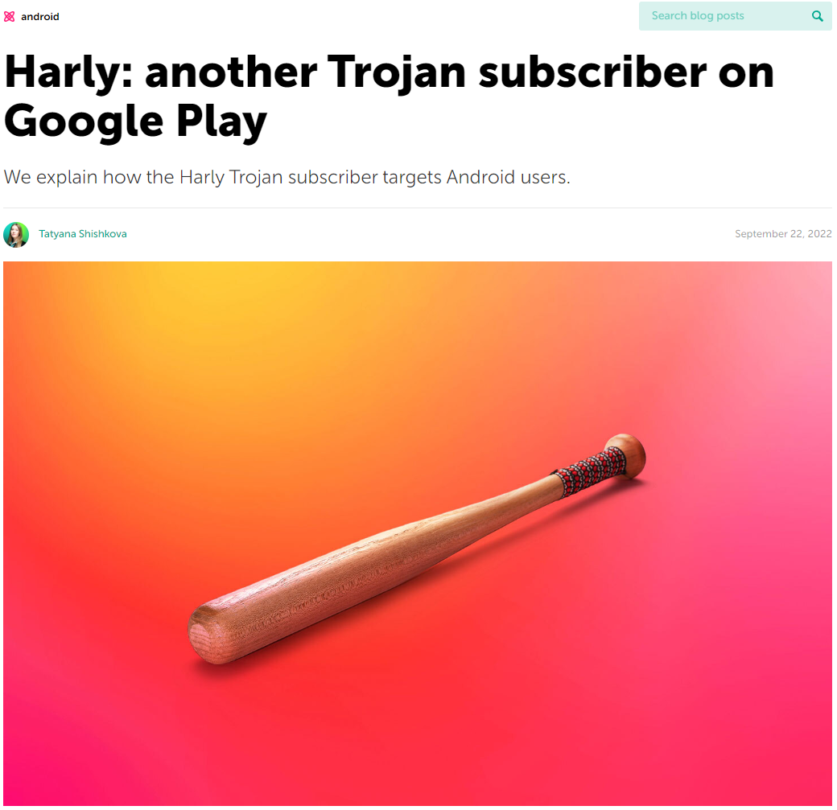
HARLY
Found by Kasperksy.
First report at 22 of September 2022.
Extensive research from Tatyana Shishkova.

Slide 27
HARLY
Not So Ok
Ok
Unsafe
Safe
Vanned
Great

Slide 28
HARLY
Trojan subscriber (paid services).
~200 apps in 2022-2023.
Estimated over 1000 apps to this day affecting 12 million users.
Encrypted SDK in Go and Rust.

Slide 29
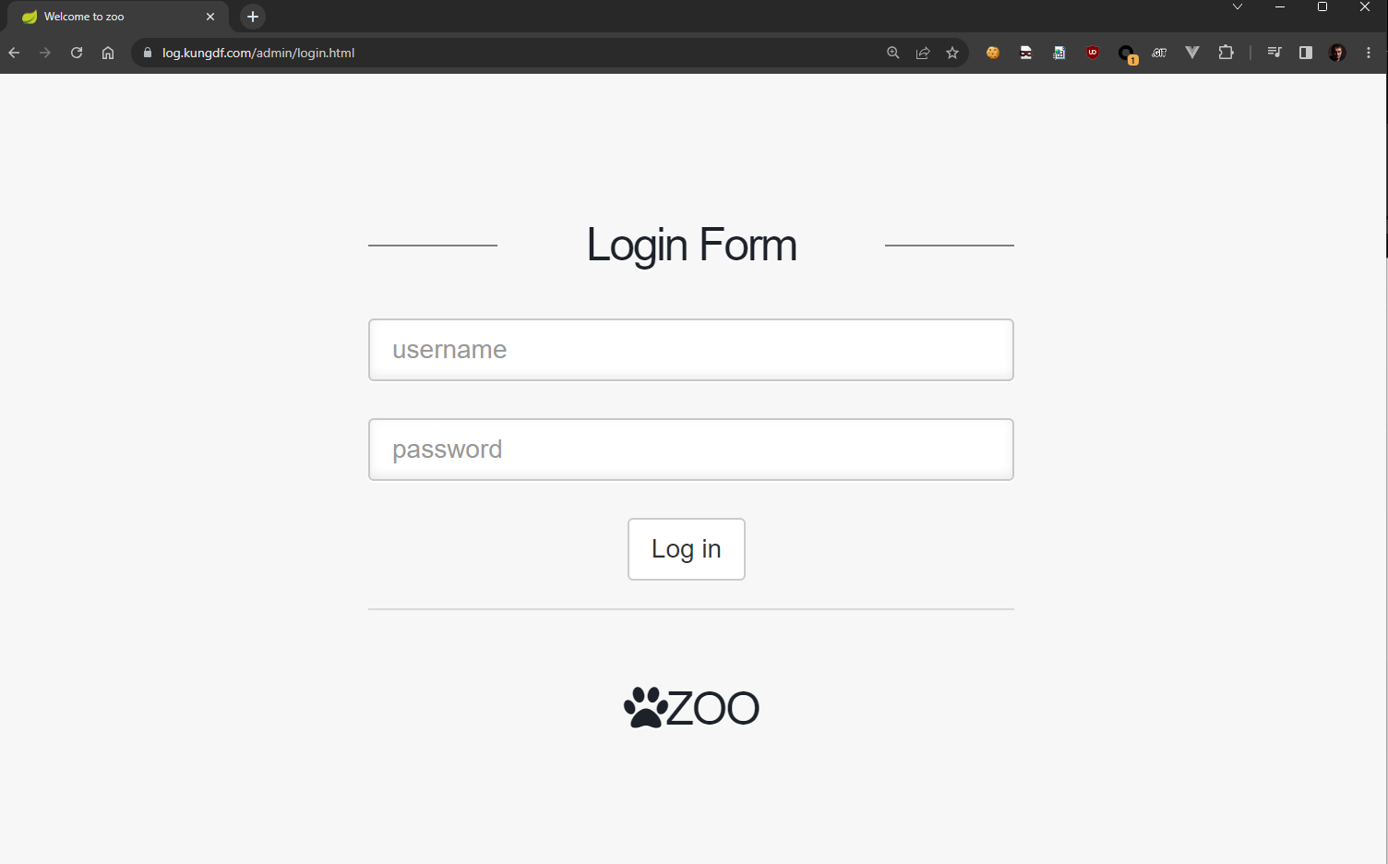
HARLY
Administration interface
Based on zoo spring app

Slide 30
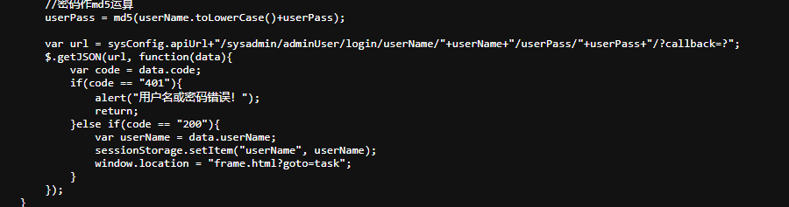
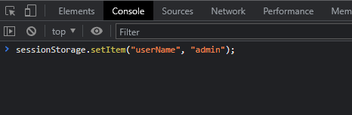
HARLY
Notes:
Avoid passive voice

Slide 31
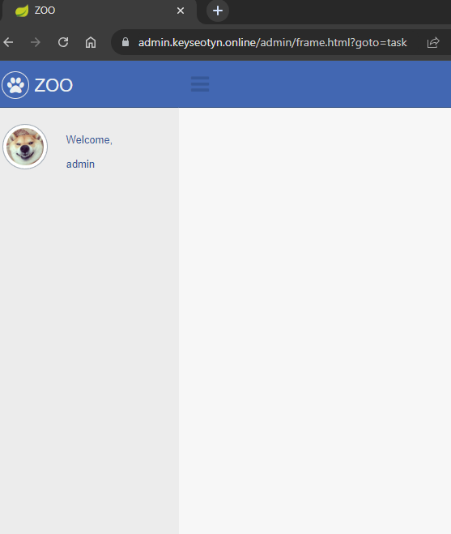
HARLY

Slide 32
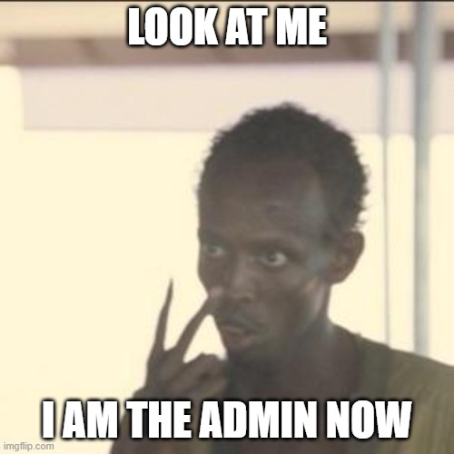
HARLY

Slide 33
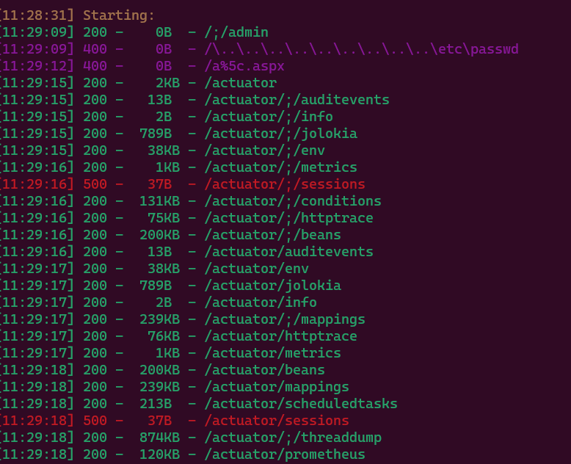
HARLY
Notes:
We NEED to get RC, [our job is not done]

Slide 34
HARLY
Boot actuators in spring framework can leak stuff.
Enter Jolokia land.
“Commercial features” were not enabled…

Slide 35
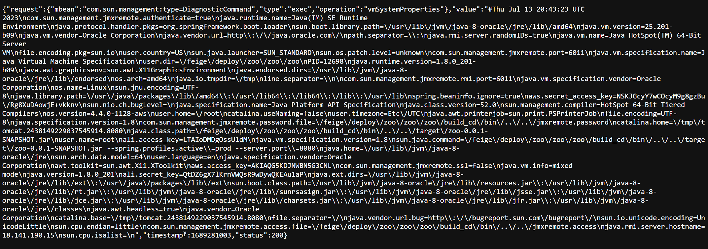
HARLY

Slide 36
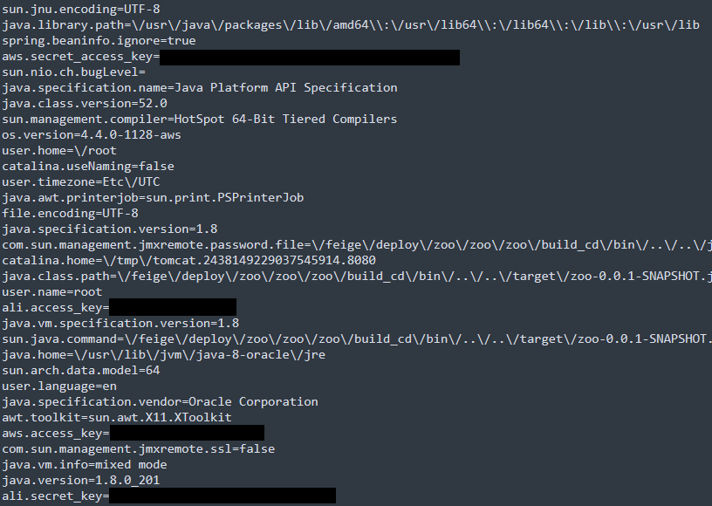
HARLY

Slide 37
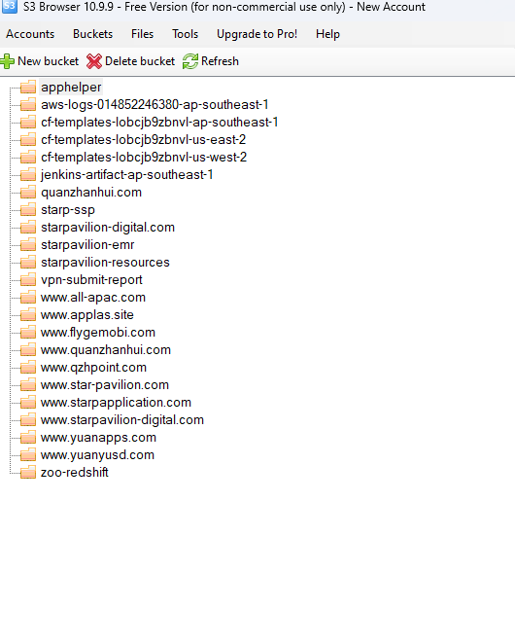
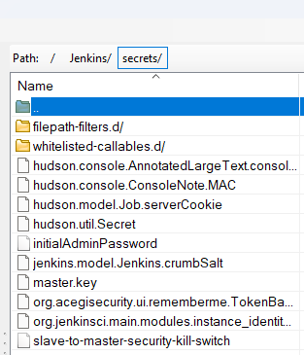
HARLY

Slide 38
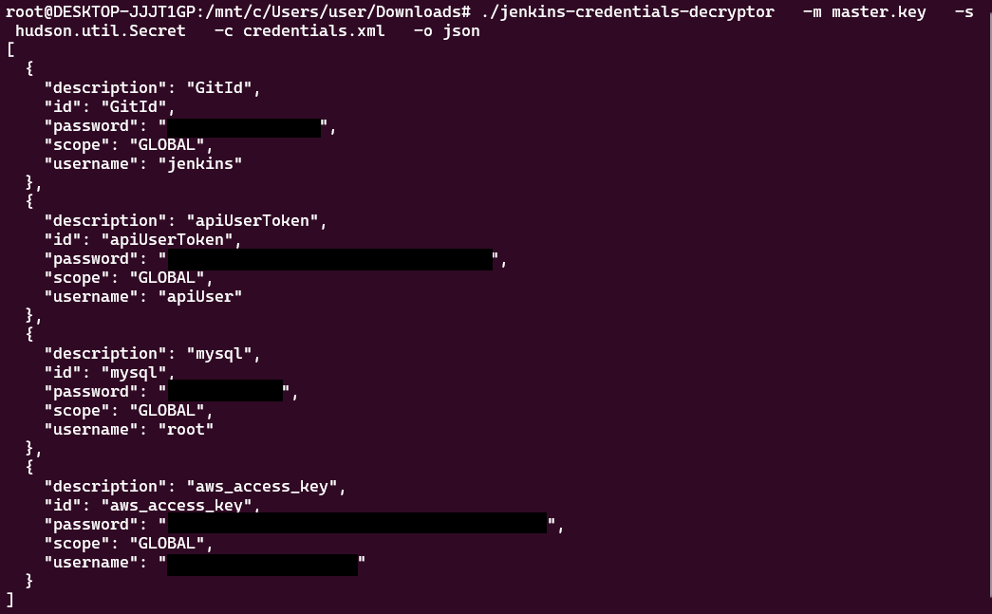
HARLY
https://github.com/hoto/jenkins-credentials-decryptor is a great project.

Slide 39
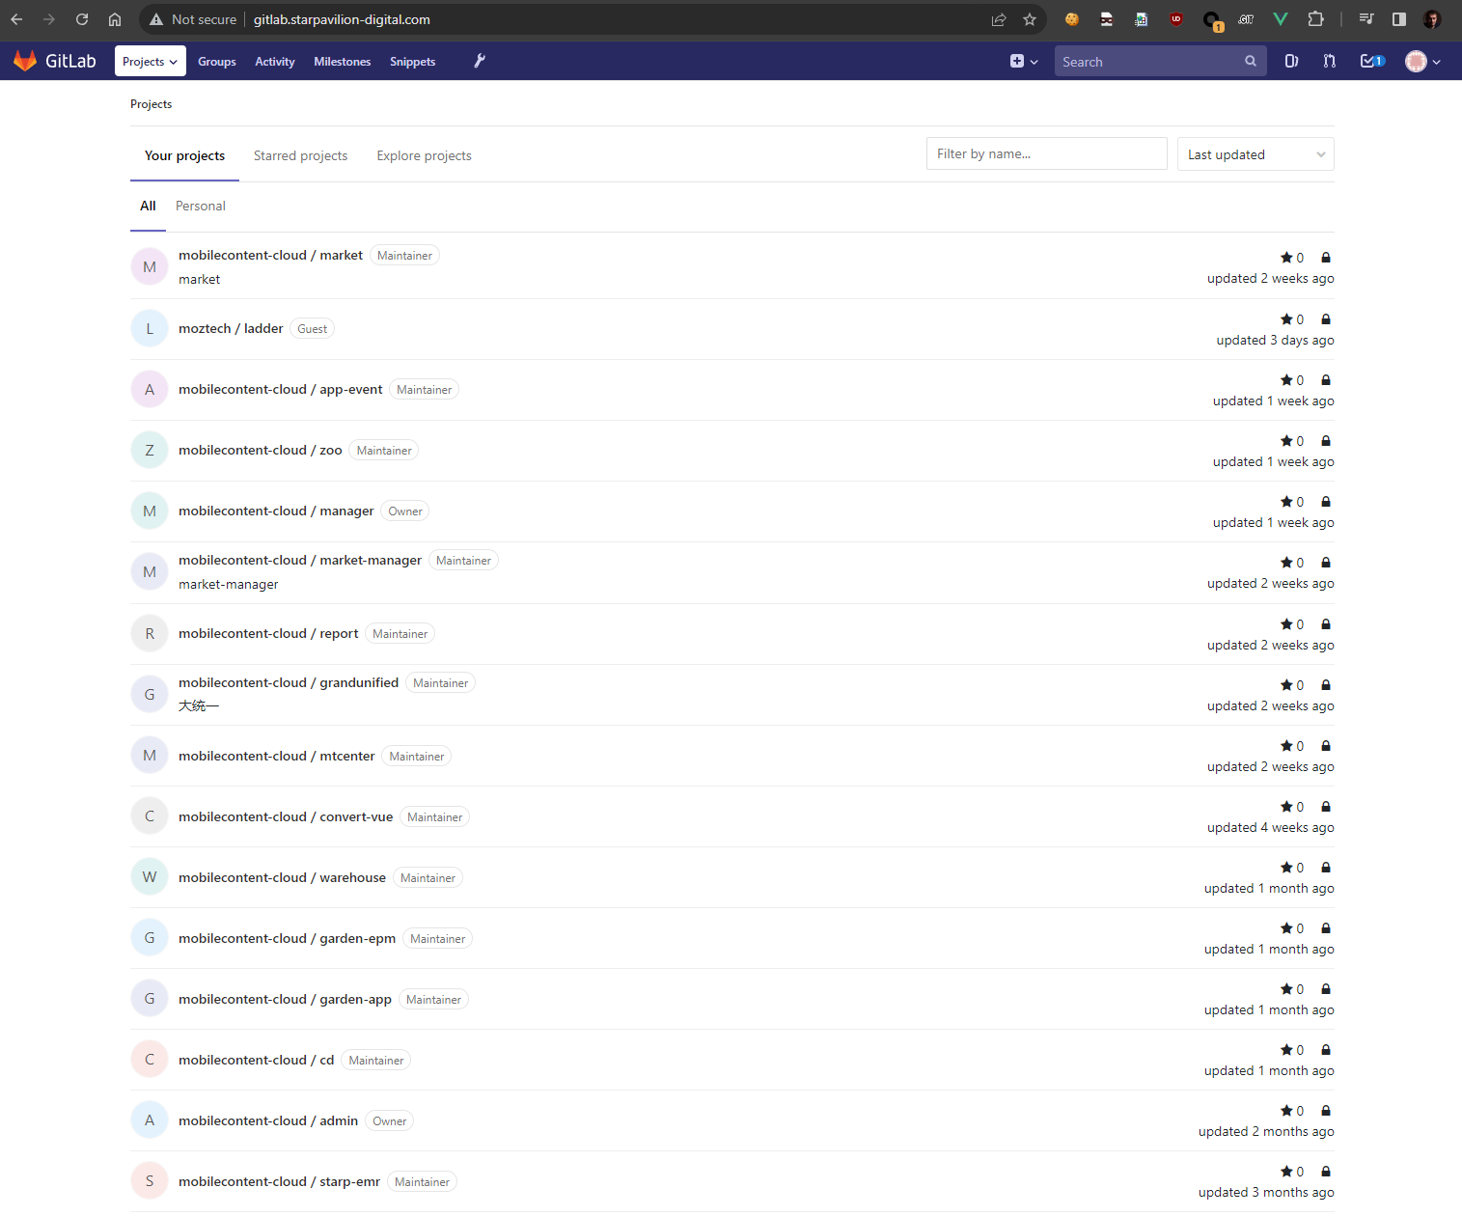
HARLY
Notes:
I , AAAND got access (θρίαμβος)

Slide 40
HARLY
All malicious app code dumped.
All C2 code dumped.
Will be shared at the end of this talk.
Notes:
Sharing is caring

Slide 41
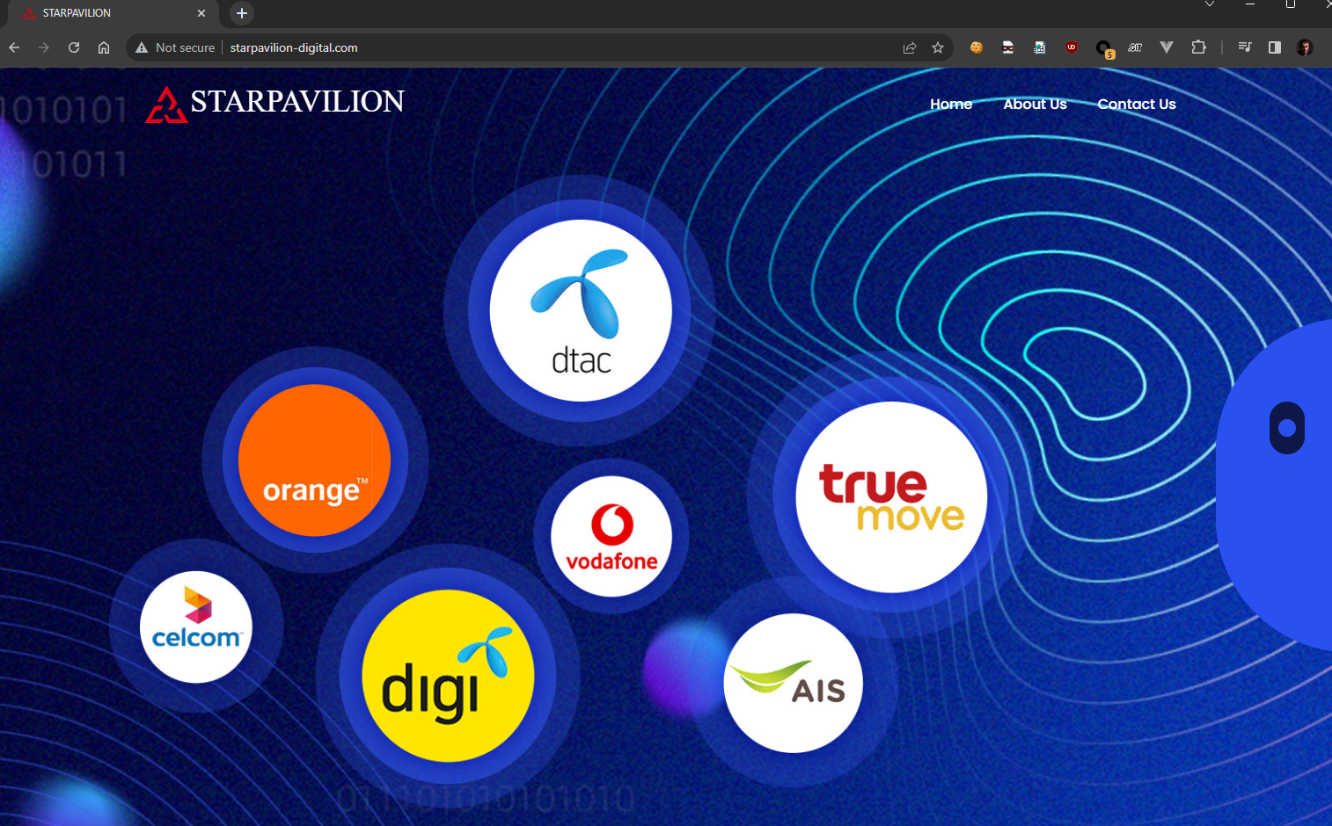
HARLY

Slide 42
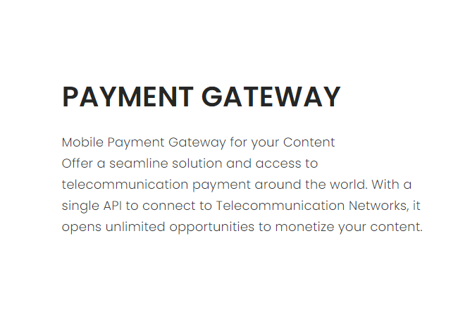
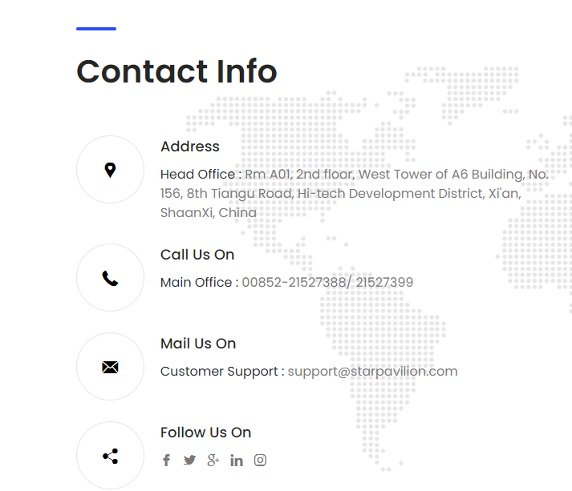
HARLY

Slide 43
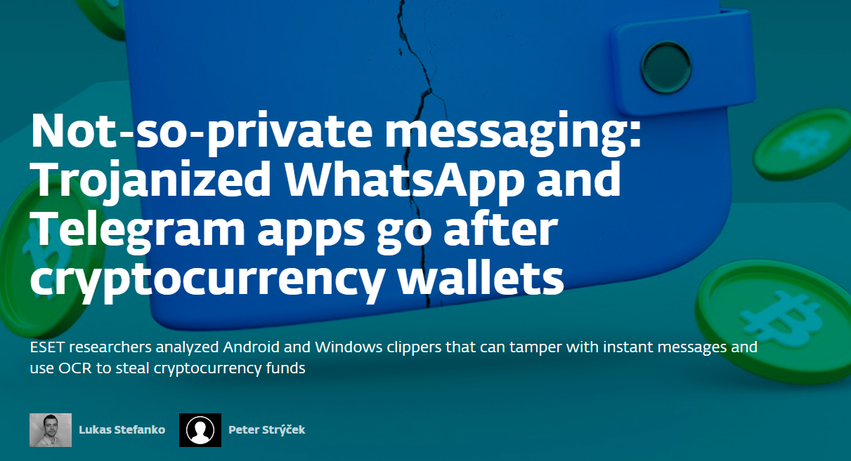
CLIPPER

Slide 44
CLIPPER
Not So Ok
Ok
Unsafe
Safe
Vanned
Great

Slide 45
CLIPPER
Reviewed by ESET, reversed by Lukas Stefanko and Peter Strýček.
Delivered as trojanized Whatsapp and Telegram messenger.
Their sole purpose is to switch wallet addresses.

Slide 46
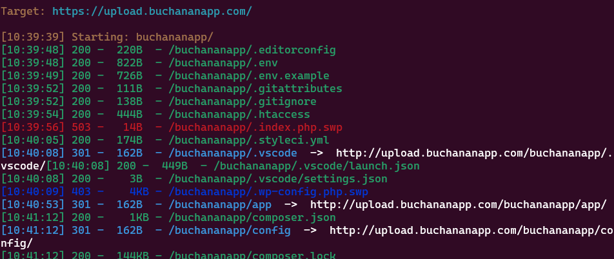
CLIPPER

Slide 47
CLIPPER
Laravel based
Environment files are juicy files
Reused files

Slide 48
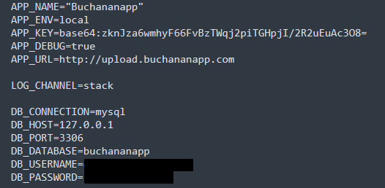
CLIPPER

Slide 49
CLIPPER
APP_KEY encrypts cookies.
Rebuild cookies and login as any user.
Superadmin!

Slide 50
CLIPPER

Slide 51
CLIPPER
Everything was public.
Now deleted (I got it though).
User has other really interesting repositories, though.
Notes:
Grey backround

Slide 52
CLIPPER
Full (i.kangna@yahoo.com)
Suju/suju8811/kevin10030 (jndev_zch0218@outlook.com)
Kevin10030 (yuan.kevin@yandex.com)
Alex Hong (alex@alexs-mac-3.local)
ZhuWon (masterlong0505@hotmail.com)
Notes:
If conditional

Slide 53
CLIPPER
Dumped all malware related repositories.
Android app was already compiled.
Shared on github.
No further information as we have bigger fish to fry.
Notes:
We - as a community, engage, είμαστε σε αυτό όλοι μαζί- κίνηση χεριών

Slide 54

AMADEY

Slide 55
AMADEY
Surfaced on October 2018
Typical Stealer
Sold in Russian forums ($400 - $800)
Usually used as a dropper for other malware.
Source was leaked 5 years ago.
Known connections to: LockBit, TA505, TA406 and TA511.

Slide 56
AMADEY
Not So Ok
Ok
Unsafe
Safe
Vanned
Great

Slide 57
AMADEY
Stray files.zip from dirsearch
Zip was password protected
Cracked in less than 24 hours.

Slide 58
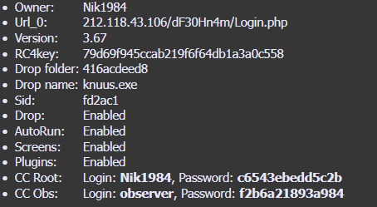
AMADEY
Cracking zip password

Slide 59
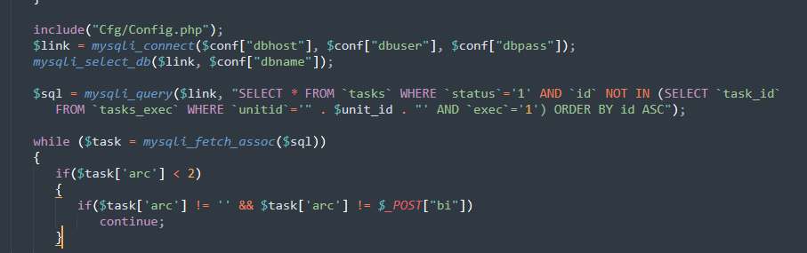
AMADEY
SQL Injection!

Slide 60
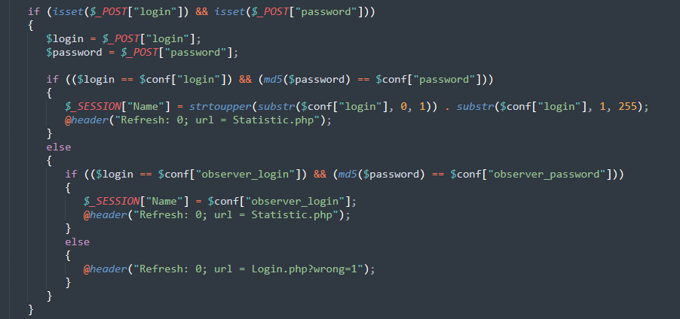
AMADEY

Slide 61
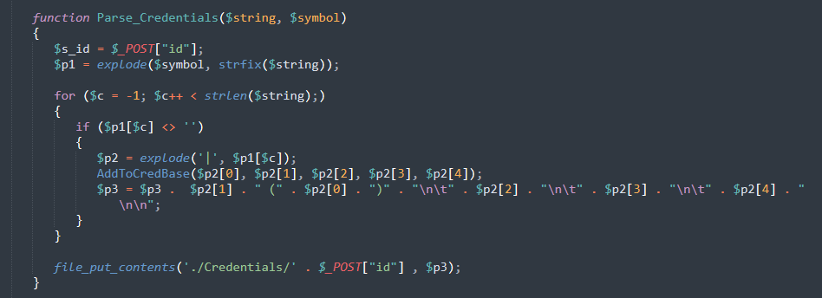
AMADEY

Slide 62
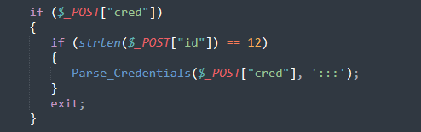
AMADEY
Limiting filename to exactly 12 characters (incl. extension)
::: as the delimiter for the String.

Slide 63
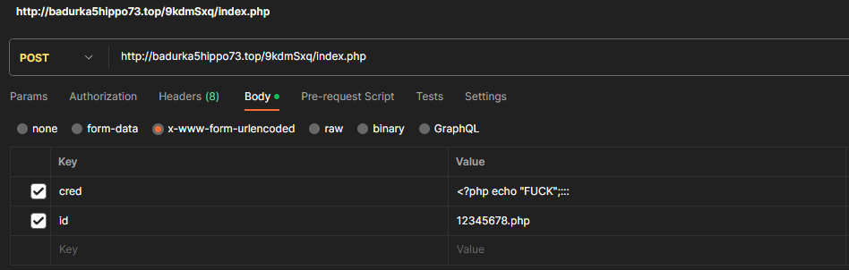
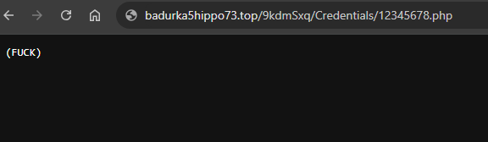
AMADEY

Slide 64
AMADEY

Slide 65
AMADEY
Reverse shell
Automated way of extracting everything in less than 30 seconds from report to full owning the website.
Added a cron job to corrupt a percentage of the files.
Unfortunately it is now fixed (late June of 2023).

Slide 66
AMADEY
> 1000 instances since December 2022
> 7 million devices compromised

Slide 67
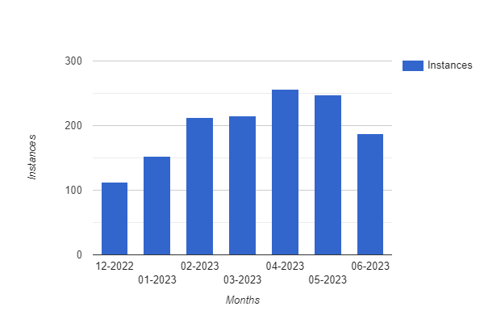
AMADEY

Slide 68
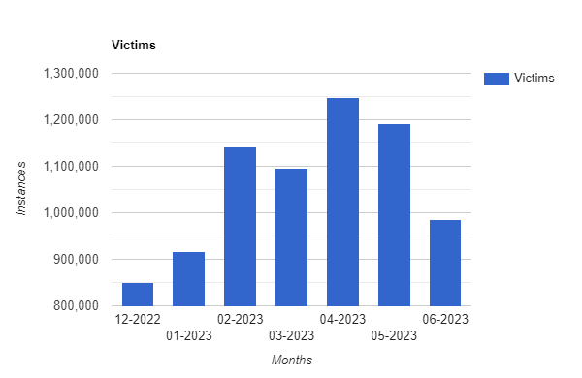
AMADEY

Slide 69
SMOKELOADER
First record in 2014.
Targets Windows.
Generic dropper for other malware.
Price for full package ~ $1600.
Known connections to: LockBit, TA505, TA406 and other TAS…

Slide 70
SMOKELOADER
Not So Ok
Ok
Unsafe
Safe
Vanned
Great

Slide 71
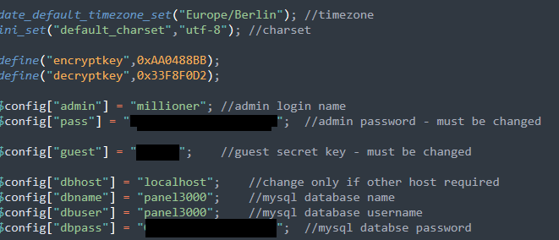
SMOKELOADER
Dirsearch to the rescue!
Stray zip file with credentials.

Slide 72
SMOKELOADER

Slide 73
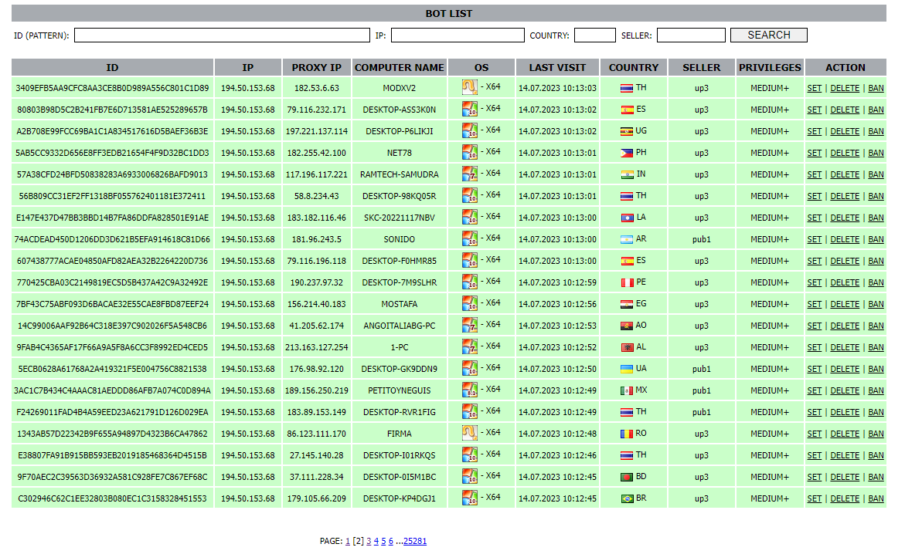
SMOKELOADER

Slide 74

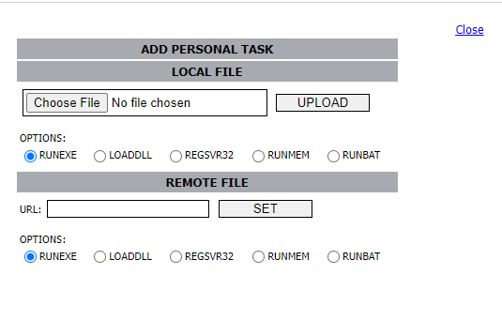

SMOKELOADER

Slide 75
SMOKELOADER
Did not manage to get RCE.
Source code available (minus the credentials as it’s still active).
All shared malware downloadable from git.

Slide 76
SMOKELOADER
Knew the default zip name of the source code.
Searching every minute for new refs in threat intel.
~ 20% vulnerable once I was quick enough!
60 different instances of Smokeloader panels.
2 had over 500k bots.
Estimated over 10 million unique devices were compromised.

Slide 77
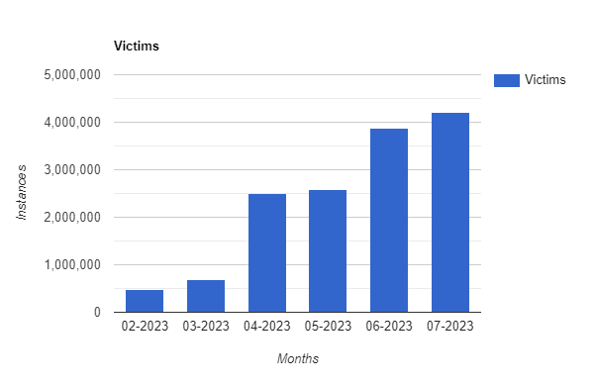
SMOKELOADER
Notes:
Number of victims (machines compromised)

Slide 78
MANIPULATED CAIMAN
Revealed and heavily researched via perception point (0xToxin with the help of @1ZRR4H and @Merlax_)
Targets mostly Mexican victims
Active for at least two years
> 55M of potential revenue
Notes:
Number of victims (machines compromised)

Slide 79
MANIPULATED CAIMAN
Not So Ok
Ok
Unsafe
Safe
Vanned
Great

Slide 80
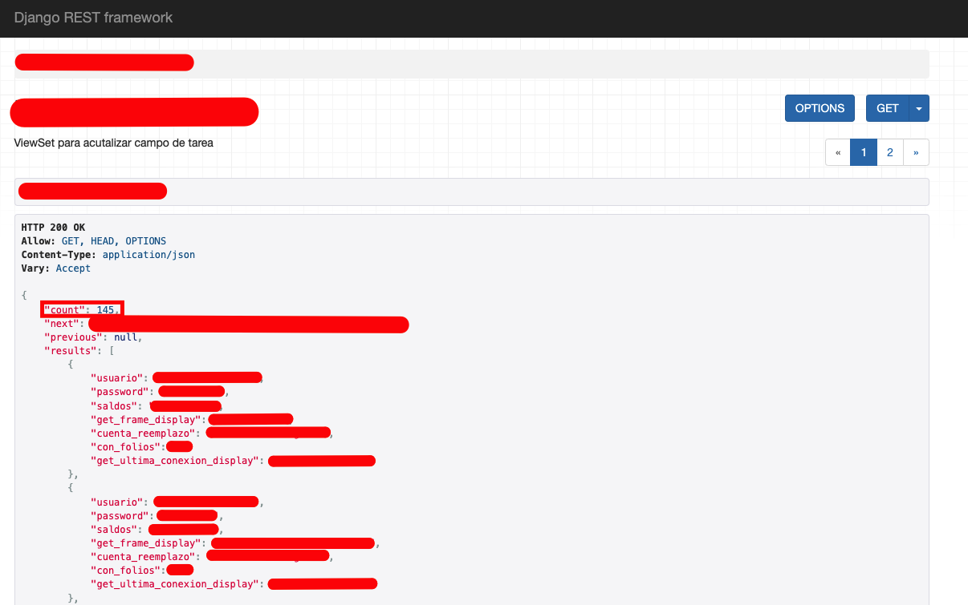
MANIPULATED CAIMAN
Notes:
Number of victims (machines compromised)

Slide 81
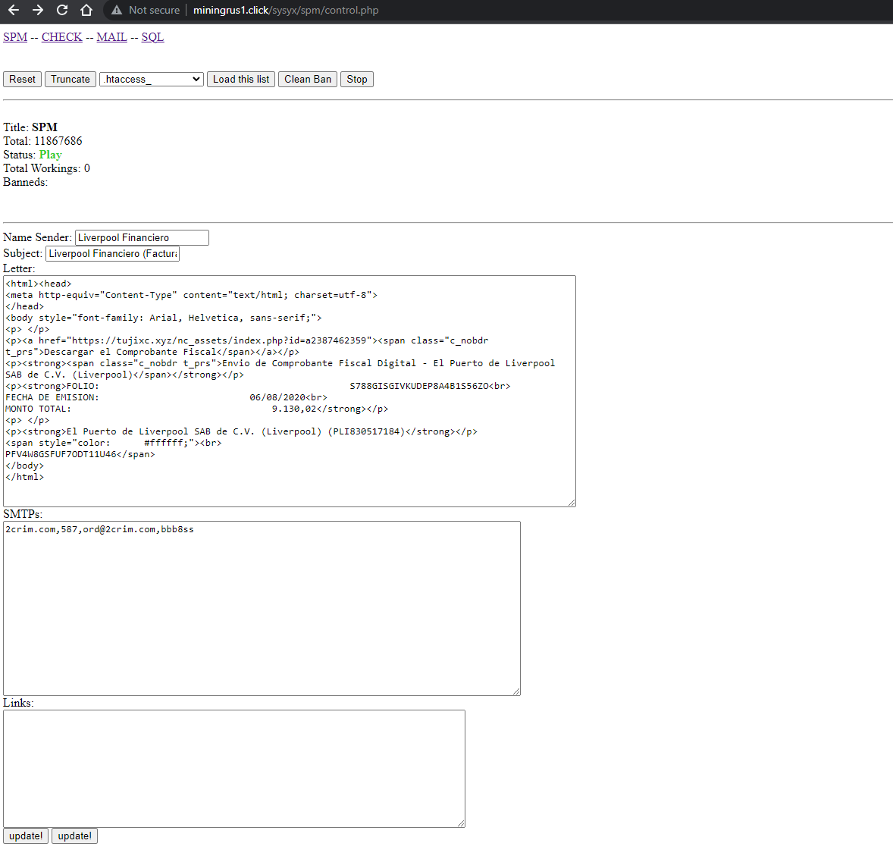
MANIPULATED CAIMAN
Notes:
Number of victims (machines compromised)

Slide 82
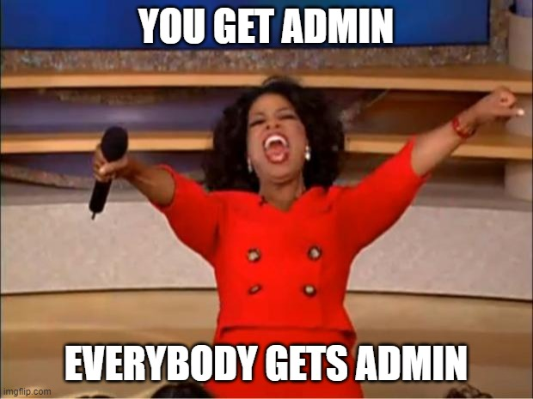
MANIPULATED CAIMAN
Notes:
Number of victims (machines compromised)

Slide 83
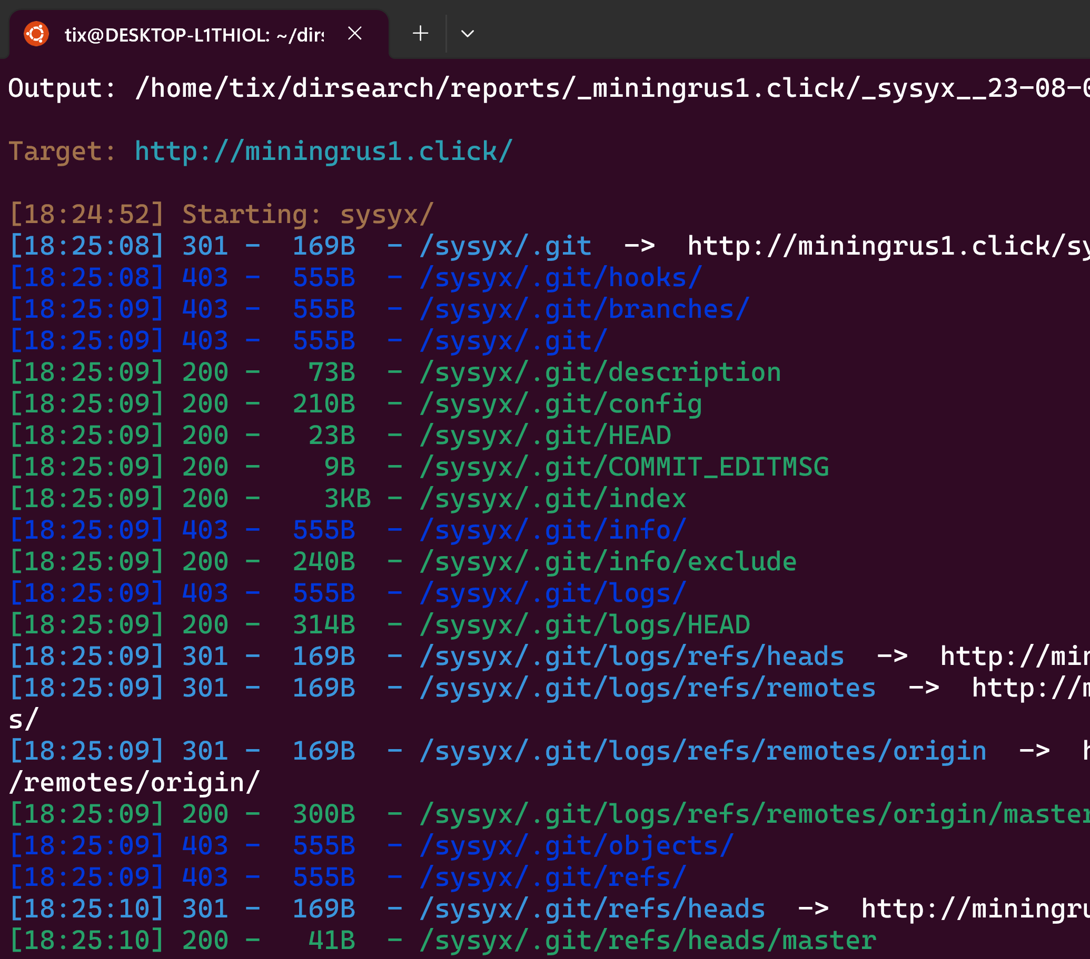
MANIPULATED CAIMAN
Notes:
Number of victims (machines compromised)

Slide 84

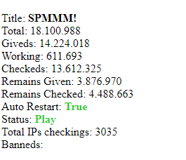
MANIPULATED CAIMAN
Notes:
Number of victims (machines compromised)

Slide 85
MANIPULATED CAIMAN
Did not manage to get RCE.
Source code available (minus the lists to not be used by spammers).
Notes:
Number of victims (machines compromised)

Slide 86
NEXUS PANEL
First appearance in 2022.
Android stealer.
Sophisticated way of bypassing MFA.
Targets 450 banking applications.
Mostly active in Turkey.
Currently inactive.

Slide 87
NEXUS PANEL
Not So Ok
Ok
Unsafe
Safe
Vanned
Great

Slide 88
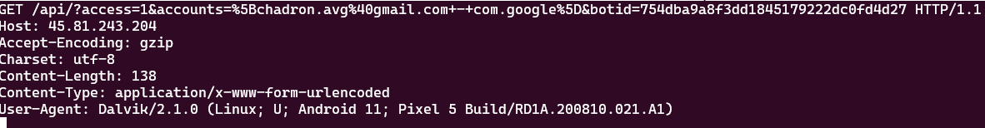
NEXUS PANEL

Slide 89
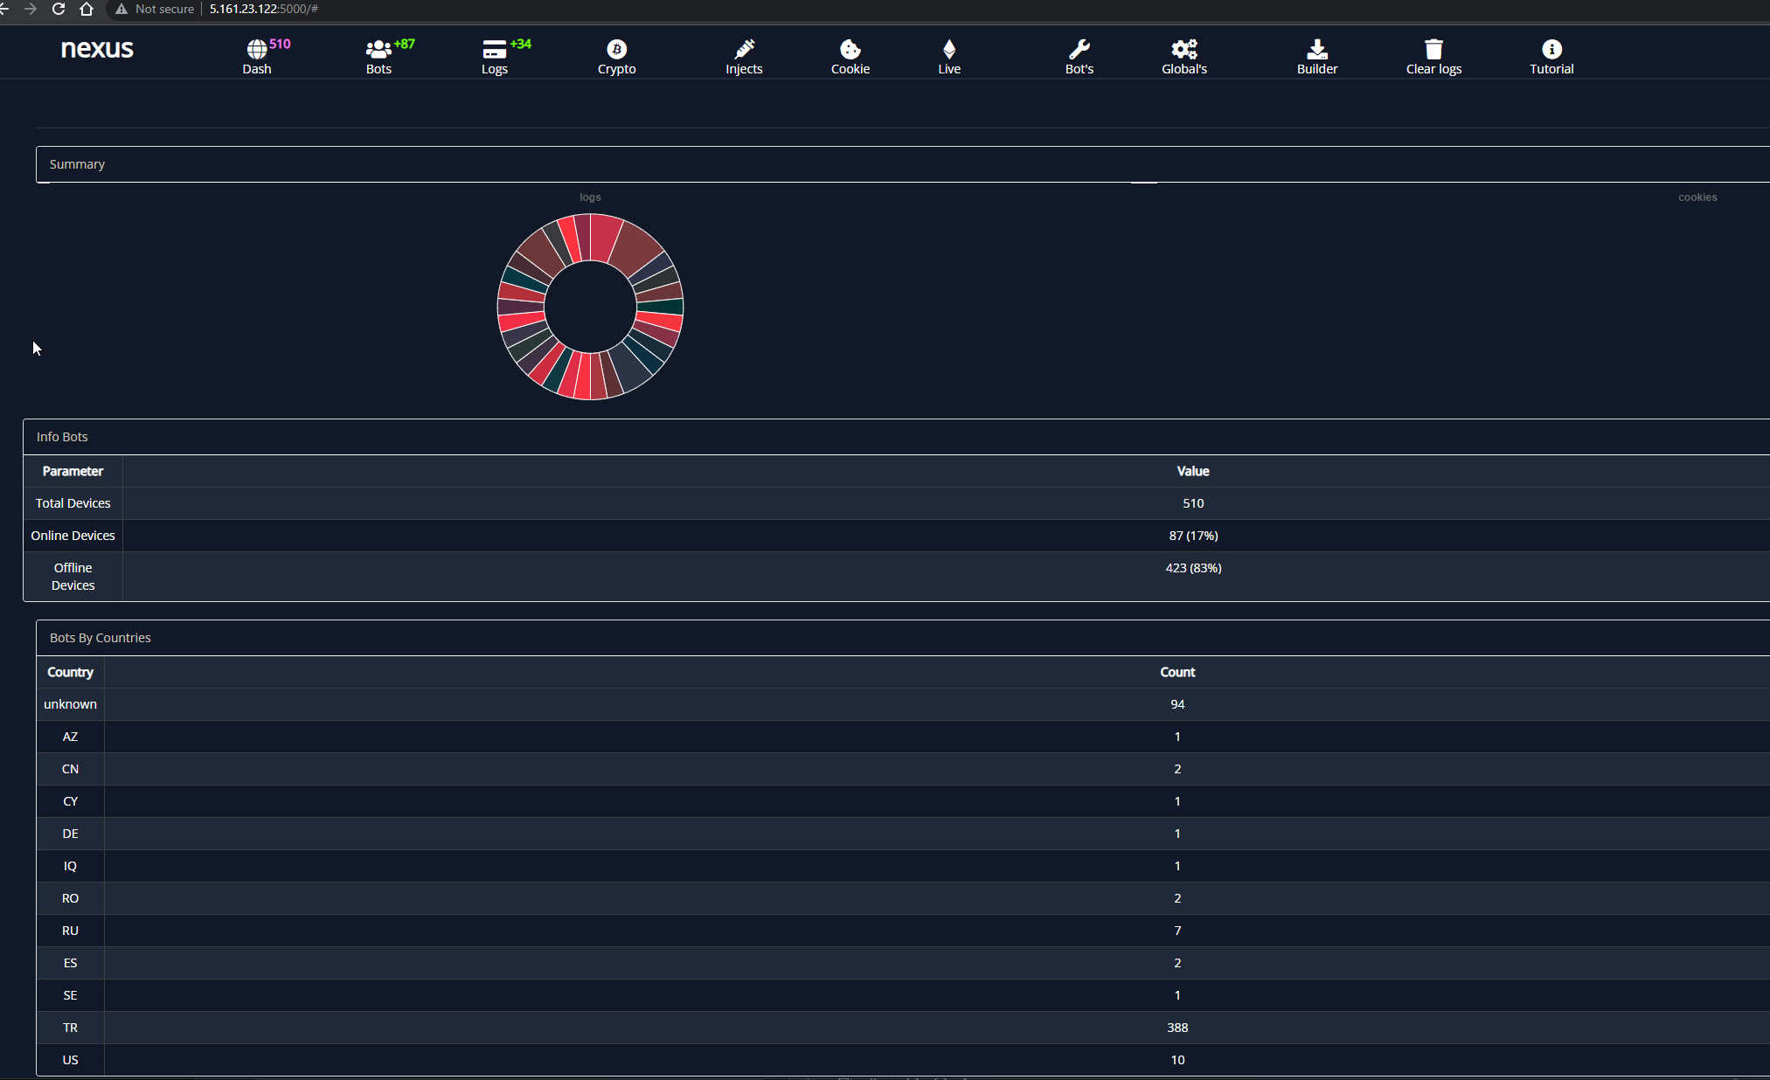
NEXUS PANEL

Slide 90
NEXUS PANEL
SQL injection could dump full database.
Clear text passwords
No code or RCE.
Unfortunately no panels are available for the past couple of months.

Slide 91
AURORA
First appearance in early 2022.
Windows stealer.
Written in Golang capable of stealing ~100 crypto wallets.
C2 panel also written in Golang

Slide 92
AURORA
Not So Ok
Ok
Unsafe
Safe
Vanned
Great

Slide 93
AURORA
Dirsearch found a stray image loading advertisements.
Followed that lead.
Found the base building server handling all builds and licensing.
You could add a user to it and create stealers.

Slide 94
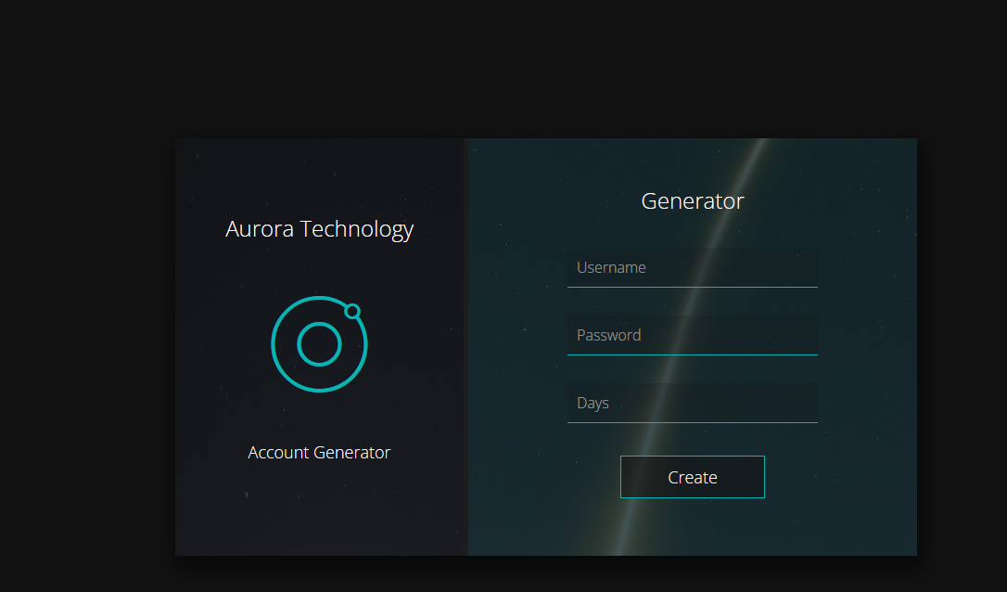
AURORA

Slide 95
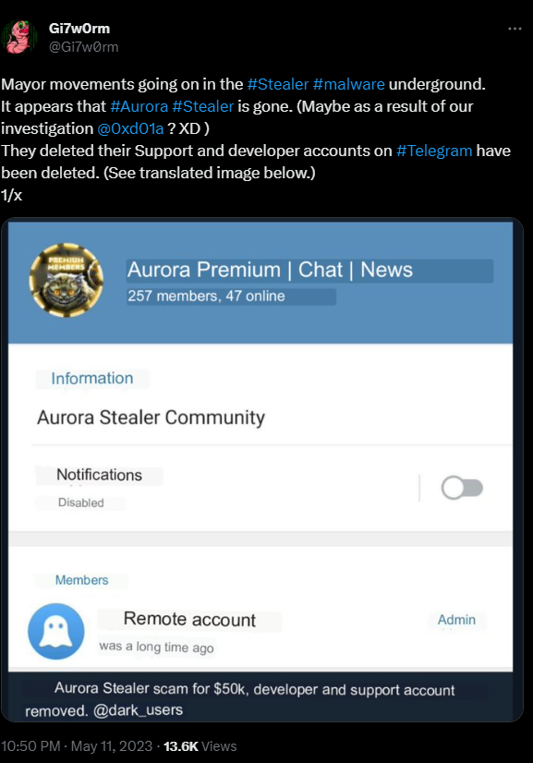
AURORA

Slide 96
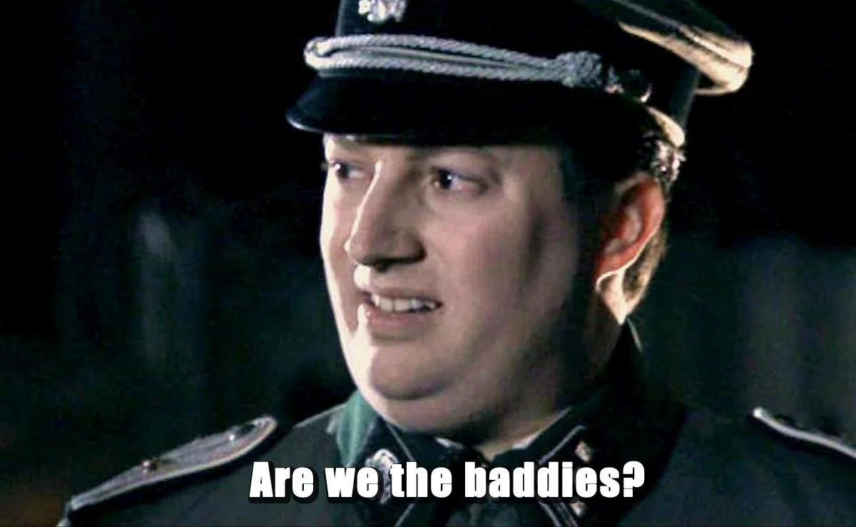
ETHICAL DILEMMAS

Slide 97
ETHICAL DILEMMAS
Criminals will get better.
C2s will get some focus too.
Bar will be raised and today’s 0-days will no longer be valid.
Could interfere with active police investigations.

Slide 98
NEXT STEPS
Continue monitoring for new panels.
Find more 0-days.
Help researchers identify criminals.
Continue my 40 years “Don’t get Vanned” Strike.

Slide 99
References
https://stykas.com/defcon31
Blog-post explaining this presentation.
https://github.com/tix/defcon31
All source code released.

Slide 100
THANK YOU

